Slide 1
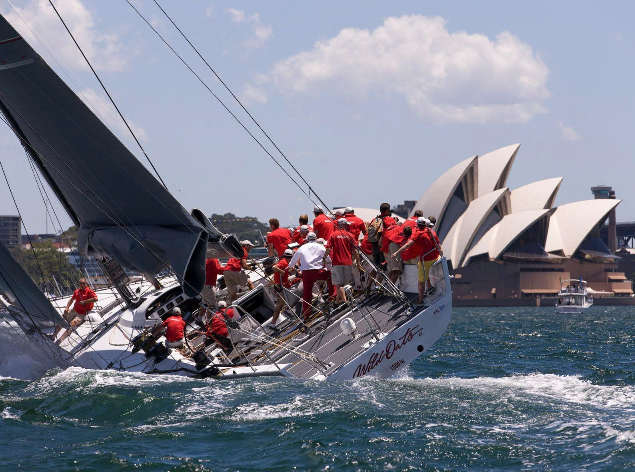



GSOE9820 Engineering Project Management
Term 3
Dr. Yu Jing

Slide 2


Slide 3

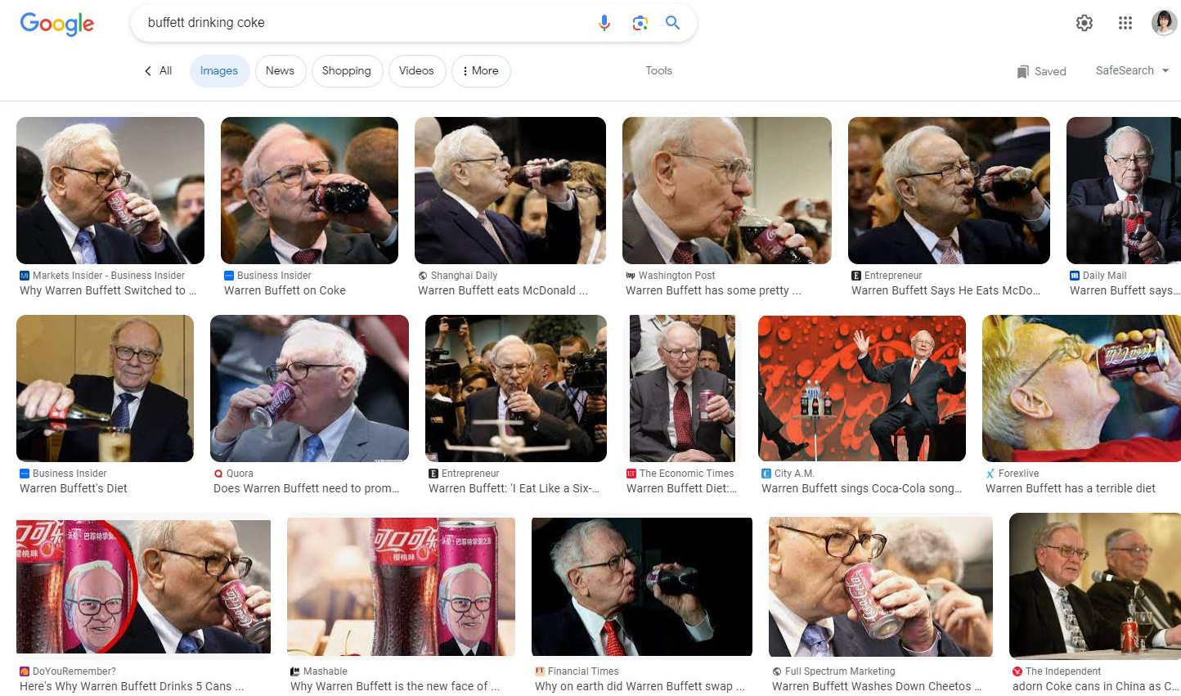
Coca-Cola
The most recognized brand in the soda world.
"I’m one quarter Coca-Cola," Warren Buffett told Fortune magazine. "If I eat 2700 calories a day, a quarter of that is Coca-Cola. I drink at least five 12-ounce servings. I do it everyday."

Slide 4




“New Coke”
Reformulate to create a sweeter and smoother taste
Blind taste tests in the market research were positive
Coca-Cola launched the new taste in April 1985: “New Coke”
“Pepsi Challenge”
Source: https://dailybrand.co.zw/the-iconic-pepsi-challenge/
Source: https://www.coca-colacompany.com/about-us/history/new-coke-the-most-memorable-marketing- blunder-ever

Slide 5


People’s reactions
The reactions of American people were negative, protesting against the loss of the original taste.
3 months after the launch, Coca-Cola changed the formular back to its classic taste.
Karma Looming via YouTube / Karma Looming via YouTube
Market research spent $4 million and last for 2 years
A loss of $30 million in back stocked products it couldn’t sell
One of the most famous failed project in history.

Slide 6

A project manager keeps the project from failing with a suite of project management tools that shepherd your project from initiation to the close.
After this course, you will be able to look at projects through the lens of a project manager and learn fundamental principles of project management, which will guide you to achieve project goals.

Slide 7

What is a Project?
Some examples:
Software development
Hardware installation for an organisation
Earth resources exploration and production
Mergers and acquisitions of organisations
Aircraft design
Building construction
Company restructuring
Research and development for a technology
…
PMBOK Guide (6th Ed) Part 1, Sec. 1.1.

Slide 8
What is a Project?
A formal definition:
'A project is a temporary endeavor undertaken to create a unique
product, service or result'.
A project’s life
Product Service Result
Beginning
End
Finite timespan: A project has definite beginning and end. A project is ended when the project goals are met, or unable to continue (e.g. budget, resources etc)
Final deliverables: Project goals/objectives are achieved by producing deliverables. A deliverable can a unique product, service, or result.
PMBOK Guide (6th Ed) Part 1, Sec. 1.1.

Slide 9

What is a Project Management?
‘Project management is the application of knowledge, skills, tools, and techniques to project activities to meet project requirements.’
Project management is to answer following questions:
What problem are you solving?
How are you going to solve the problem?
What’s your plan to get the project done?
How will you know when you are done?
How well did the project go?
Project manager
PMBOK Guide (6th Ed) Part 1, Sec. 1.1.

Slide 10
What does a Project Manager do?
The project manager is the person assigned to lead the team, responsible for achieving the project objectives.
A good project manager should have following skills but not limited to:
Technical skills
Project manager
Management proficiencies (develop and manage scope, schedules, costs, quality, resources, risks)
Interpersonal skills (establishing and maintaining active communication with stakeholders)
PMBOK Guide (6th Ed) Part 2, Sec. 1.7.

Slide 11
Project Life Cycle
The life cycle provides the basic framework for managing the project.
All projects, regardless of the specific work involved, follow below life cycle structure:
Project phases
Starting the project
Organizing & preparing
Carrying out the work
End the project
A project life cycle is the series of phases that a project passes through from its beginning to its completion.
Phases are time-bound, with a start and end or control point.

Slide 12
Project Process Groups
At each project phase, there are processes to be employed to meet project objectives.
They are grouped into 5 process groups:
Monitoring & Controlling
Initiating
Planning
Executing
Closing

Slide 13
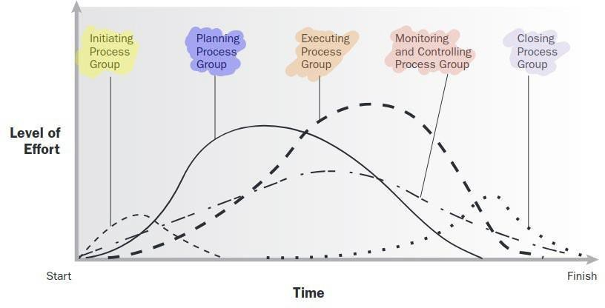
Project phases ≠ Process groups
Starting the project
Organizing & Preparing
Carrying out the work
Ending the Project
Project phases
Process groups
PMBOK Guide (6th Ed) Part 2, Sec. 1.5 – 1.9 (Figure 1-5)

Slide 14
Initiating | Weeks 1 - 4
Deciding what you are going to do, showing why this is beneficial, get commitments of stakeholders, and obtaining authorisation to start the project.
Key processes:
Identify stakeholders
Defining the project scope: problems, objectives, requirements, deliverables etc.
Develop the project charter
Assign a PM
PMBOK Guide (6th Ed) Part 2, Sec. 2.

Slide 15
Planning | Weeks 1 - 6
Deciding how you are going to achieve the objectives and create the
roadmap that you will follow.
Key processes:
Work Breakdown Structure (WBS)
Schedule: define activities, activity duration and scheduling
Cost: estimate cost and determine budget
Quality: set quality targets and measures
Resource: HR, procurement plan, activity resources
Communication : tools, frequency
Risk management: identify and analyse risks, solutions
Procurement plan
Develop the Project Management Plan: integrate components
PMBOK Guide (6th Ed) Part 2, Sec. 3.

Slide 16
Executing | Outside the scope
This is when you get to execute the project plan. You bring recourses on board, get people to perform the work, and manage the project.
Key processes:
Develop and manage the team
Directing project work
Completing work planned in PMP
Coordinating resources
Managing stakeholders
Integrating activities (project manager’s most critical job)
Conduct procurements
PMBOK Guide (6th Ed) Part 2, Sec. 4.

Slide 17
Monitor & Control | Weeks 7 - 8
While the work is underway, you need to track the progress, monitor and control the project. If the project is out of track, work out the solutions.
Key processes:
Gather data: starting date, duration, costs
Evaluate progress: compare against the plan, check objectives, schedule, cost, quality etc.
Readjust your plan
Request change: approve or reject the change
Perform integrated change: manage scope, schedule, cost, quality after the change
Report progress of the change
Monitor and control risks
PMBOK Guide (6th Ed) Part 2, Sec. 5.

Slide 18
Closing | Week 9
When the project is over, you should post-review the project, evaluate success, and celebrate achievements.
Key processes:
Interpret success
Identify lessons learned
Measure stakeholder satisfaction
Finalise costs
Formally close out project activities
Give recognition for achievements
PMBOK Guide (6th Ed) Part 1, Sec. 4.7.

Slide 19
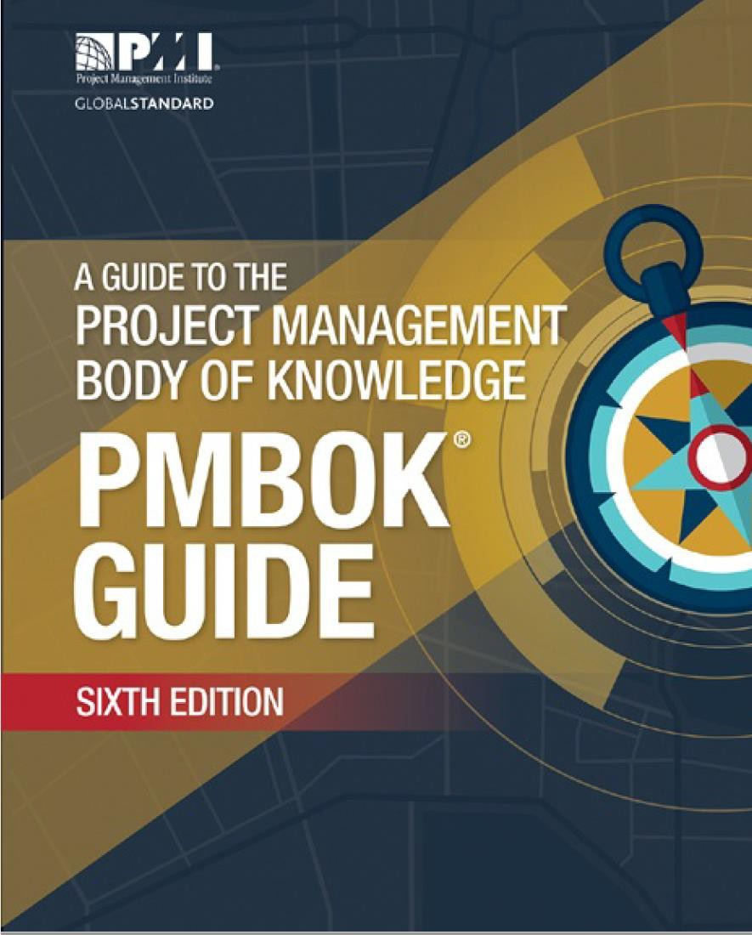
PMBOK
‘PMBOK’ stands for the ‘Project Management Body of Knowledge’.
A Guide to the Project Management Body of Knowledge (PMBOK(R) Guide– Sixth Edition
After this course, PMBOK will be easier to understand and follow.

Slide 20





Slide 21

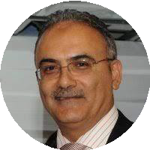
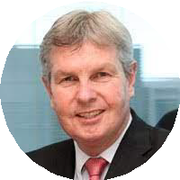
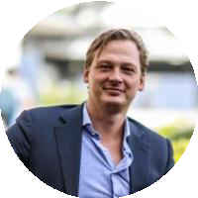

Teaching Team
Course convener and lecturer
Dr. Yu Jing
Scientia Lecturer
School of Minerals and Energy Resources Engineering
Guest lecturer
Mr. Bernard Hayes
Former engineering executive of global infrastructure company
Casual lecturer at UNSW and UTS
Guest lecturer
Rei Yamagishi
Senior managing consultant TwoCollaborate
Guest lecturer
Mr. Ibrahim Dani
PMO Manager at Seven Consulting
Guest lecturer
Dirk Vos
Founder, Director TwoCollaborate

Slide 22
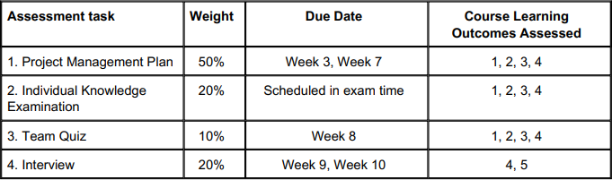
Assessments
Course learning outcomes:
Translate from organisational strategy into project deliverables
Formulate project scope
Select and apply project management methods
Integrate and justify project plans
Evaluate progress and interpret success in projects

Slide 23
Project Management Plan (PMP)
Task 1 - Scope Definition (Individual)
5%
Due in Week 3
Assess the Initiating process
What to cover:
Define the purpose of your project.
Draw a work breakdown structure (WBS) diagram down to the work package level.
Write a scope statement for your project.

Slide 24
Project Management Plan (PMP)
Task 2.1 - PMP Components (Group)
40%
Due in Week 7
Group assignment
Assess the Planning process
What to cover: develop the Project Management Plan (PMP), while demonstrating the application of PM methods.

Slide 25
Project Management Plan (PMP)
Task 2.2 - Individual Progress Check Presentation (Individual)
5%
Week 6
In the week 6 meeting with your demonstrators, students are requested to show and summarise the work that they have completed for their PMP project.
1-min presentation.

Slide 26
Project Management Plan (PMP)
Task 3 - PMP Integration (assessed via interviews)
20%
Week 9, 10
Assess the Monitoring and Controlling process
What to do:
Hand in PMP change (changes in budget, scope, assumptions and risks)
PMP Integration: Review and improve your PMP, with a particular focus on integration between the different parts.
Updated PMP is not graded, but will be referred in the interviews scheduled in Week 10.

Slide 27

Project 1 – Solar Farm
It is proposed for UNSW to engineer / procure and construct a small commercially sized PV solar farm on a 35 hectare site owned by UNSW in rural NSW. This facility will be connected to the Grid and will provide UNSW with renewable energy on a commercial basis. Additionally, it will be designed to allow further expansion and so
permit novel solar PV panel/support designs to be added to test at the commercial scale phase of their development. There will be remote control and monitoring installed to allow performance evaluation remotely back on the UNSW campus. The vision of constructing this Developmental Solar Farm is to provide UNSW students the opportunity to study solar energy utilization and facilitate research and development into advancing PV Solar Energy technology whilst providing UNSW with a renewable energy supply source.
Duration: Accept
Budget: $25M (fixed)
Scope: Optimise
Sponsor: Bernard

Slide 28
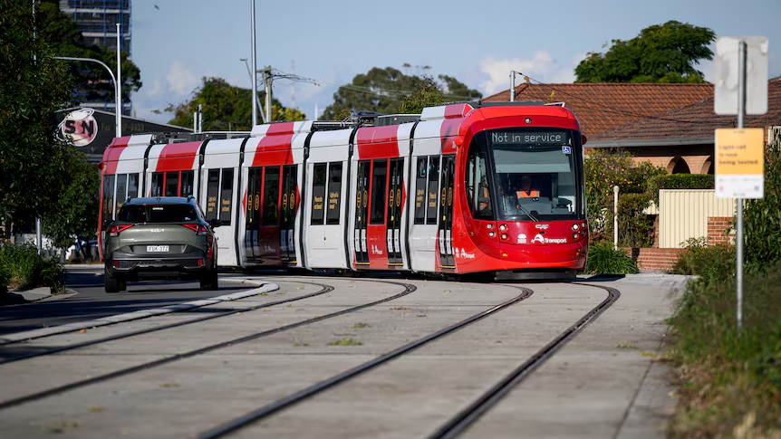
Project 2 – Uplifting the NSW’s Government new Parramatta Light Rail
In this hypothetical scenario, Transport for NSW (TfNSW) wishes to gain deeper insights into how their customers interact with and Light Rail platforms. Their interest aligns with the development of the new Parramatta Light Rail Stage 1 network, specifically the new Westmead to Carlingford segment. TfNSW will likely require some form of people counting technology installed on platforms.
As of August 2024, the latest progress updates from TfNSW indicate that major construction on all 16 light rail stops of the Stage 1 network is complete, and testing of the light rail vehicles is taking place until a planned opening in late 2024.
Duration: Begin from the 1st January 2025 and be completed by 31st December 2025 inclusive
Budget: $800,000 AUD
Scope: Optimise
Sponsor: Dylan

Slide 29

Project 3 – Low-SES Secondary schools Engagement Platform
Australia has one of the most socially segregated schooling systems among high-income countries (OECD, 2018). These disparities in the Australian school system lead to vastly different educational opportunities and experiences for students from diverse backgrounds.
One of the main barriers to university education for students from disadvantaged backgrounds in Australia is academic performance in secondary school, as measured by the ATAR or equivalent (Gale and Parker, 2013). As a result, students from educationally disadvantaged backgrounds are often less likely to gain entry into universities, particularly elite institutions such as those in the Group of Eight (Go8), which have more competitive admissions processes.
Duration: 18 months
Budget: $250000
Scope: Optimise
Sponsor: Cindy

Slide 30
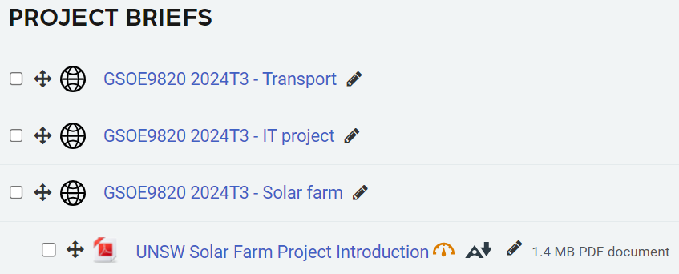
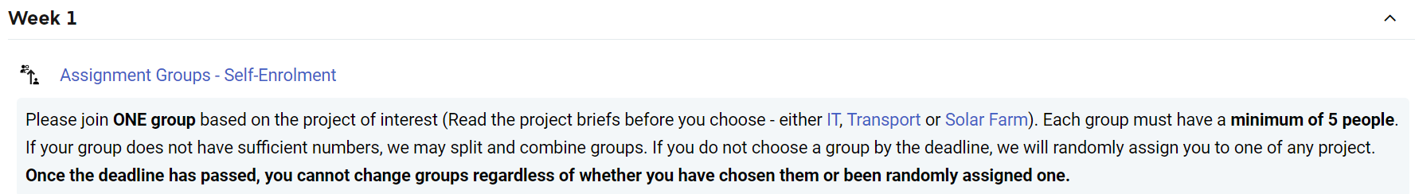
Select project topic on Moodle
Project briefs can be found on Moodle
Select project topic
Find your teammates (5-6)
Self-enrolment Due: Week 1 5pm Sunday
Weekly check-in meetings with your demonstrator from Week 2

Slide 31
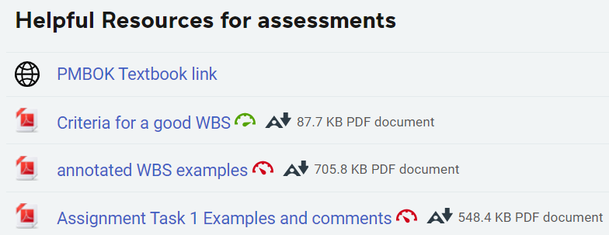
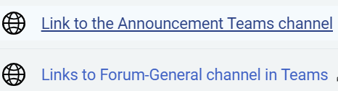

Slide 32
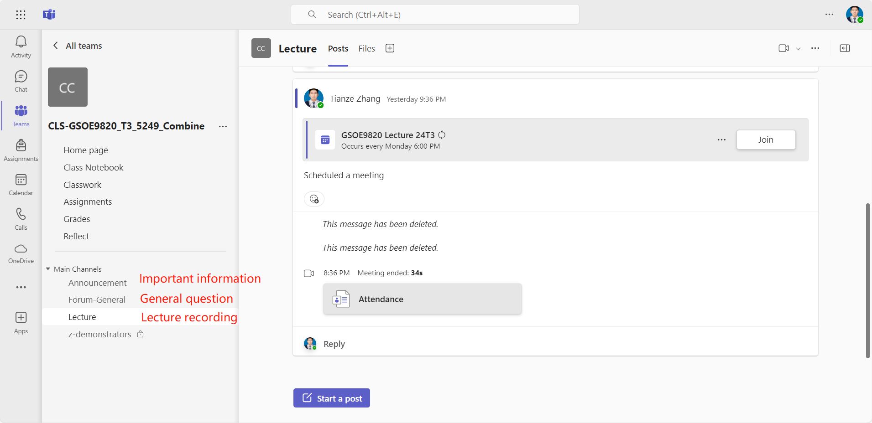

Slide 33
Activities
Lectures
Weekly, from Week 1
Mondays 6pm – 9pm
2-3 hours
Demo meetings
Weekly, from Week 2
Time is determined by
demonstrators
~12 min/group
Team based learning (TBL)
Project management plan (PMP2)
Case study
Group online quiz
Individual activities
Project management plan (PMP1)
Online quiz
Interview
Final exam

Slide 34
Communication and Teamwork
Communication tools: MS Teams, check it regularly
Forum channels on Teams for questions (general and project-related). In Week 6, project sponsors will respond to the project-related questions.
Teamwork is essential for this course:
Set shared goals
Make a plan
Agree on tools
Allow different roles
Picture success, and include a part for everyone
Lots of peer review and feedback opportunities.

Slide 35
 | Topics | Tasks | Assignment hand-ins
Week 1 | Scope, project charter, WBS | Select project topic on Moodle
Week 2 | Design Thinking
Week 3 | Agile | Moodle practice quiz | PMP Task 1 (5%)
Week 4 | Scheduling, risk management, estimating and budget
Week 5 | PMP integrating workshop
Week 6 | PMP Q&A | Progress check presentation (5%)
Week 7 | Project Controls | Moodle practice quiz | PMP Task 2 (40%)
Week 8 | Project controls application exercise | Case study quiz (10%)
Week 9 | Successful stories of project management | Interview Preparation | PMP Task 3
Week 10 |  | Moodle practice quiz Interviews (20%)
Exam Week |  | Examination (20%)

